Slide 1
Session 3
Installing R and Rstudio

Slide 2
Objective of the session
To learn how to install R and R studio
How to open R studio

Slide 3



INTERFACE
This is how user interact with R

Slide 4
https://cran.r-project.org/bin/windows/base/

Slide 5
https://posit.co/download/rstudio-desktop/

Slide 6
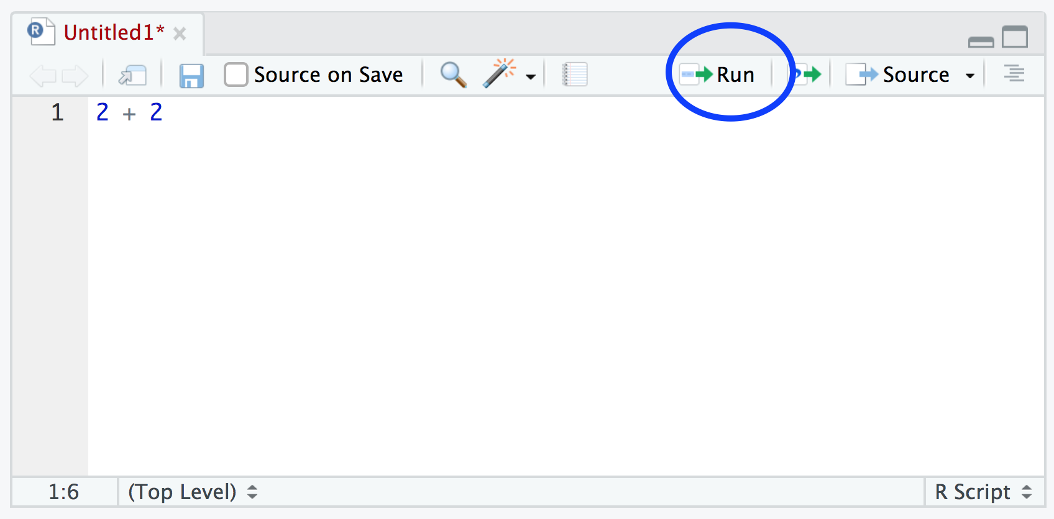

Slide 7
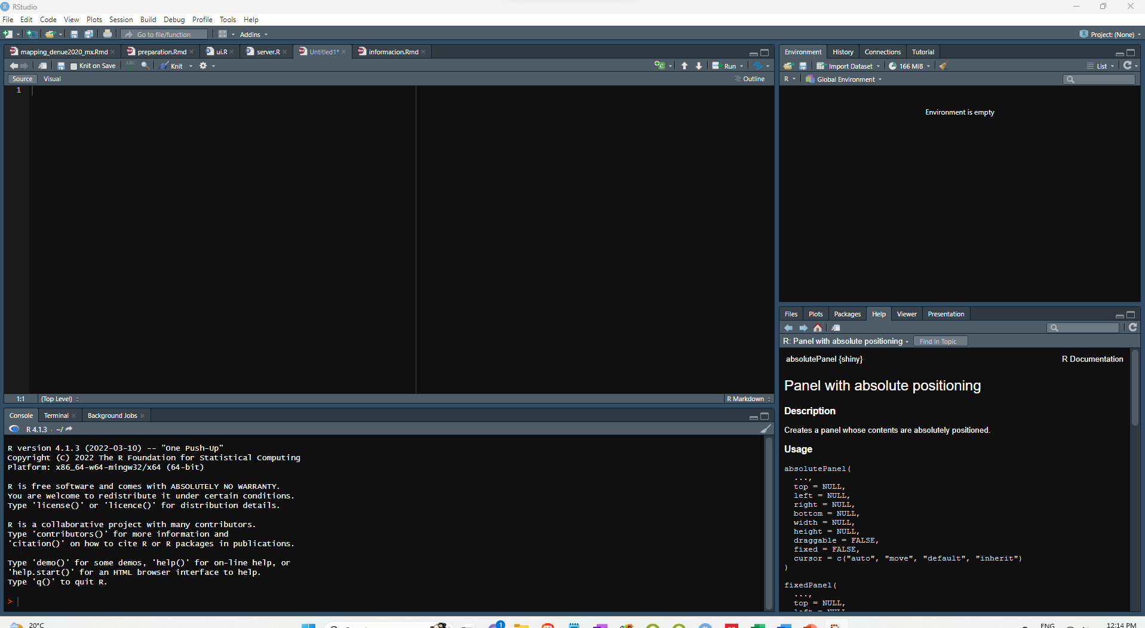
SCRIPT
DATA
OBJECTS
CONSOLE

